Slide 1
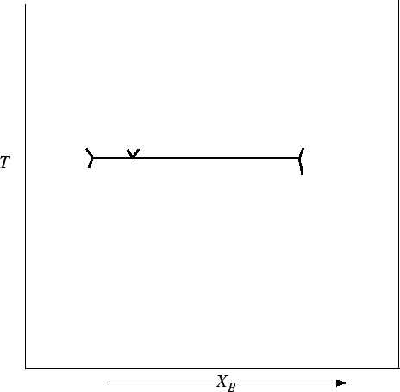
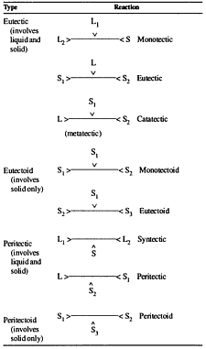
You can draw Eutectic phase diagram stating from the eutectic reaction
Liquid
α
β
α+β

Slide 2
Other Phase Diagrams
Eutectoid
Peritectic
Peritectoid
δ γ + ε
γ + L δ
α+ γ δ

Slide 3
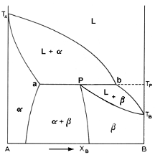
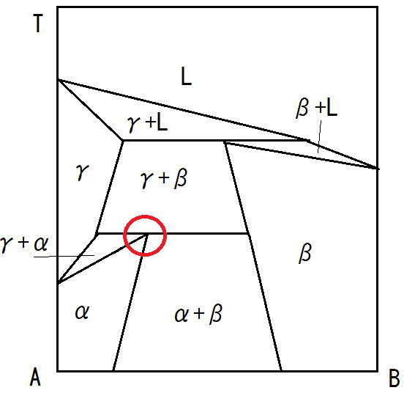
Peritectic and Peritectoid Phase Diagrams
Peritectic
Peritectoid

Slide 4
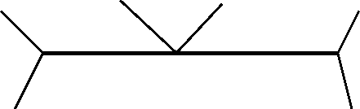
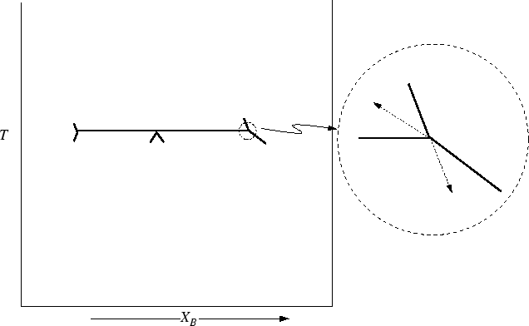
Eutectic
Eutectoid
Single Phase
Two solid Phases
Peritectic
Peritectoid
Two Phases
Single Phase
solid

Slide 5
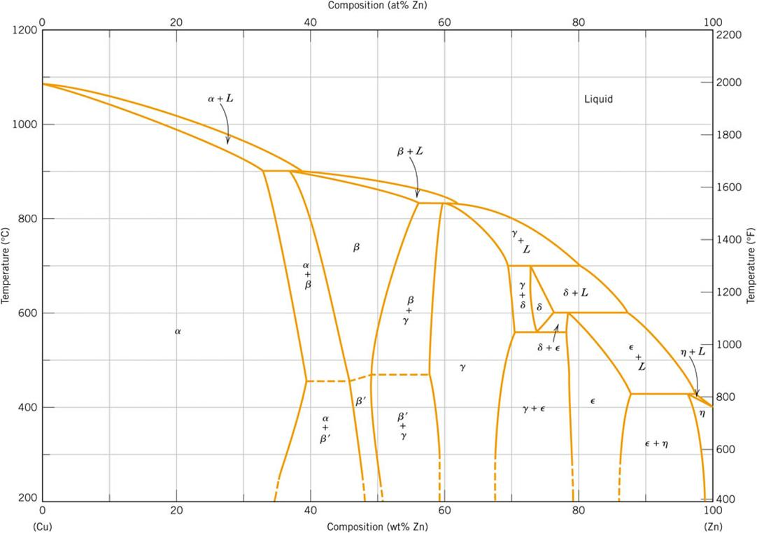
Cu-Zn : Intermediate Phases
Notes:
f19_09_pg283.jpg

Slide 6
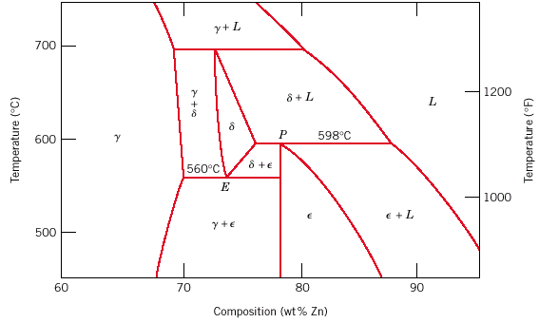
Eutectoid & Peritectic
Peritectic transition γ + L δ
Cu-Zn Phase diagram
Eutectoid transition δ γ + ε

Slide 7
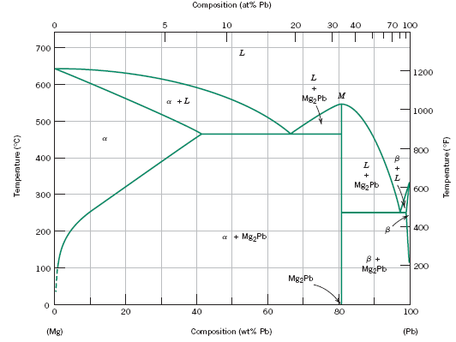
Intermediate/ Intermetallic Compounds
Not isomorphous with either of the components of the alloy system
Congruently melting intermediate phases → Intermetallic phase
Mg₂Pb
Note: intermetallic compound forms a line - not an area - because stoichiometry (i.e. composition) is exact.

Slide 8
Few Principles about Phase Diagrams
One phase regions may touch each other only at single points (point of congruent transformation), never along a boundary
Adjacent one phase regions are seperated from each other by 2 phase regions involving the same 2 phases
Three 2 phase regions must originate upon three phase isotherm
Two three phase isotherms may be connected by a 2 phase region provided that there are 2 phases which are common to both of the three phase equilibria
All boundaries of 2 phase fields must project into 2 phase fields when they join a three phase isotherm

Slide 9
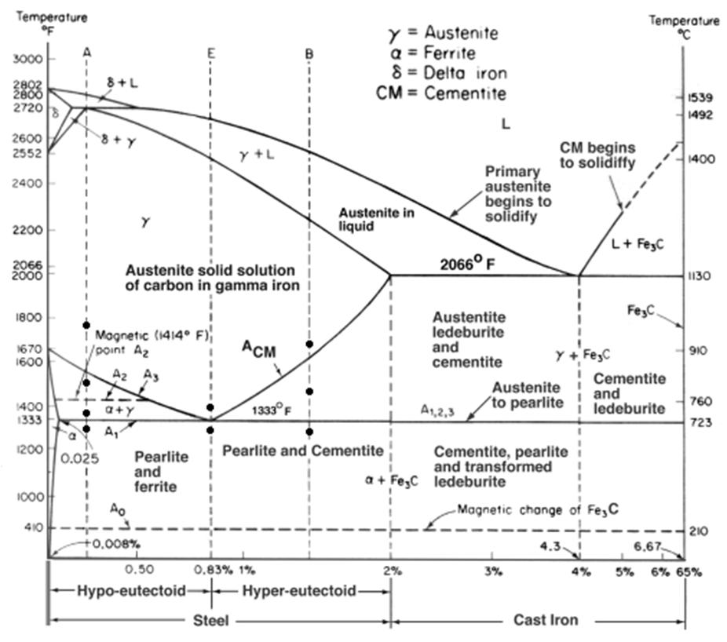
Fe-Cementite Phase Diagram

Slide 10
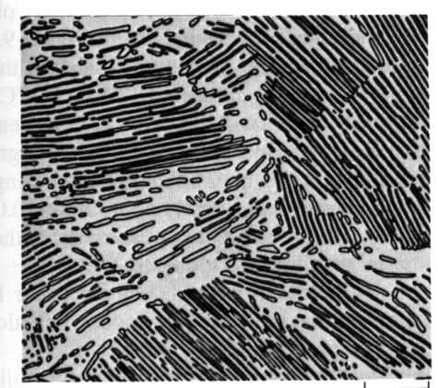
Iron-Carbon (Fe-C) Phase Diagram
• 2 important
T(°C)
points
1600
δ
-Eutectic (A):
1400
L
L
⇒
γ
+
Fe₃C
γ
γ
+L
1200
A
L+Fe₃C
-Eutectoid (B):
(austenite)
1148°C
R
S
γ
⇒
α
+
Fe₃C
1000
γ
γ
γ
+Fe₃C
α
γ
γ
800
+
γ
Fe₃C (cementite)
α
B
727°C = T
eutectoid
R
S
600
α
+Fe₃C
400
0
1
2
3
4
5
6
6.7
(Fe)
0.76
4.30
C_{o}, wt% C
120 μm
Result: Pearlite =
Fe₃C (cementite-hard)
alternating layers of
eutectoid
α
(ferrite-soft)
α
and Fe₃C phases
(From Fig. 7.27, Callister Adapted Version.)
C

Slide 11
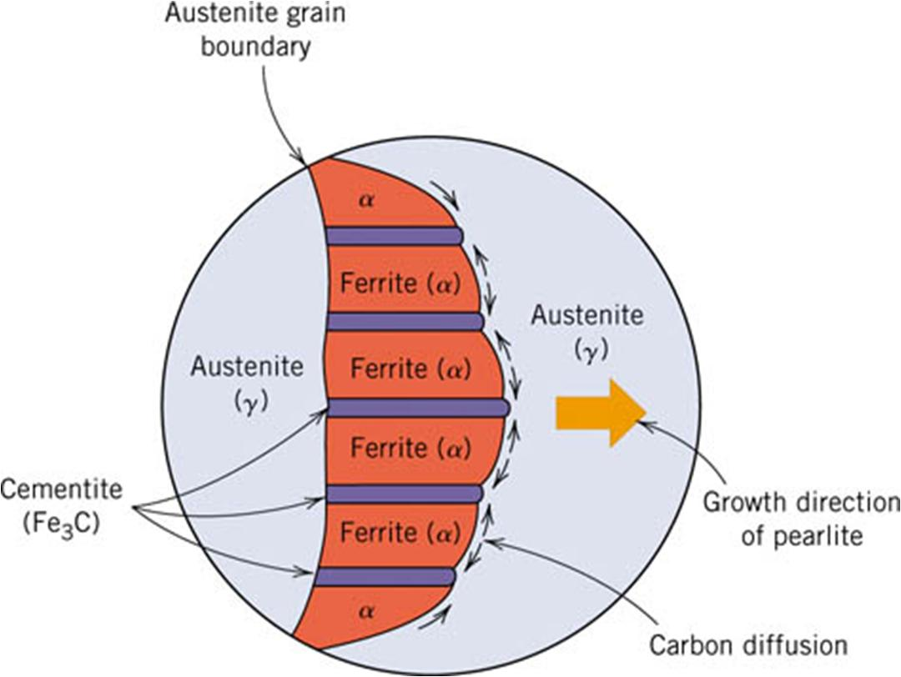
Growth of Pearlite colony
Notes:
f28_09_pg295.jpg

Slide 12
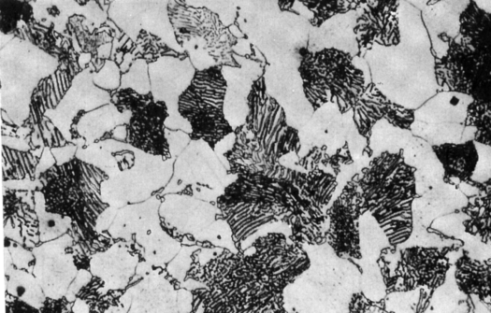
Hypoeutectoid Steel
T(°C)
1600
δ
1400
L
γ
γ
γ
+L
(Fe-C
γ
γ
System)
γ
1200
1148°C
L+Fe₃C
(austenite)
γ
γ
γ
γ
1000
γ
+ Fe₃C
α
Fe₃C (cementite)
α
γ
γ
800
r
s
727°C
γ
α
γ
α
R
S
w
α
=
s
/(
r
+
s
)
600
α
+ Fe₃C
w
=
(1-
w
)
γ
α
α
400
0
1
2
3
4
5
6
6.7
(Fe)
0.76
C_{o} , wt% C
pearlite
C₀
w
pearlite
=
w
γ
w
=
S
/(
R
+
S
)
100 μm
Hypoeutectoid
α
steel
w
Fe₃C
=
(1-
w
α
)
pearlite
proeutectoid ferrite

Slide 13
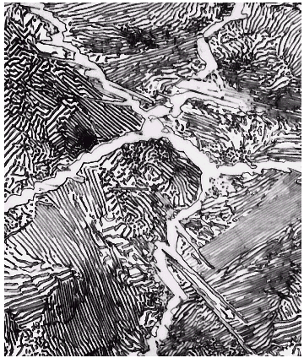
Hypereutectoid Steel
T(°C)
1600
δ
1400
L
(Fe-C
γ
γ
+L
System)
γ
γ
γ
γ
1200
1148°C
L+Fe₃C
(austenite)
γ
γ
γ
γ
1000
γ
+Fe₃C
Fe₃C
r
s
Fe₃C (cementite)
γ
γ
800
γ
γ
α
R
S
w
=
r
/(
r
+
s
)
600
α
+Fe₃C
Fe₃C
w
γ
=(1-
w
Fe₃C
)
400
0
1
C_{o}
2
3
4
5
6
6.7
(Fe)
0.76
C_{o} , wt%C
pearlite
w
pearlite
=
w
γ
w
α
=
S
/(
R
+
S
)
w
=
(1-
w
α
)
60 μm
Hypereutectoid
Fe₃C
steel
pearlite
proeutectoid Fe₃C

